Slide 1
Deep Learning for Natural Language Processing
Kyunghyun Cho
New York University
Courant Institute (Computer Science) and Center for Data Science
Facebook AI Research

Slide 2
Agenda
Text Classification & How to Represent a Sentence
Language Modelling
Machine Translation
If time permits, some recent advances…

Slide 3
Text Classification
Input: a natural language sentence/paragraph
Output: a category to which the input text belongs
There are a fixed number of categories
Examples
Sentiment analysis: is this review positive or negative?
Text categorization: which category does this blog post belong to?
Intent classification: is this a question about a Chinese restaurant?

Slide 4
How to represent a sentence
A sentence is a variable-length sequence of tokens:
Each token could be any one from a vocabulary:
Examples
(커넥트, 재단에서, 강의, 중, 입니다, .)
Vocabulary: All unique, space-separated tokens in Korean
(커넥트, 재단, 에서, 강의, 중, 입니다, .)
Vocabulary: All uniqued, segmented tokens in Korean
(커, 넥, 트, [], 재, 단, 에, 서, [], 강, 의, [], 중, [], 입, 니, 다, .)
Vocabulary: All Korean syllables
And many more possibilities…

Slide 5
How to represent a sentence
A sentence is a variable-length sequence of tokens:
Each token could be any one from a vocabulary:
Once the vocabulary is fixed and encoding is done, a sentence or text is just a sequence of “integer indices”.
Examples:
(커넥트, 재단, 에서, 강의, 중, 입니다, .)
(5241, 827, 20, 288, 12, 19, 5)
Index | Token
5 | .
12 | 중
19 | 입니다
20 | 에서
… | …
288 | 강의
827 | 재단
… | …

Slide 6
How to represent a token
A token is an integer “index”.
How do should we represent a token so that it reflects its “meaning”?
First, we assume nothing is known: use an one-hot encoding.
: the size of vocabulary
Only one of the elements is 1:
Every token is equally distant away from all the others.

Slide 7
How to represent a token
How do should we represent a token so that it reflects its “meaning”?
First, we assume nothing is known: use an one-hot encoding.
Second, the neural network capture the token’s meaning as a vector.
This is done by a simple matrix multiplication: where is the token’s index in the vocabulary.
Table Lookup

Slide 8
How to represent a sentence – CBoW
After the table-lookup operation,* the input sentence is a sequence of continuous, high-dimensional vectors:
The sentence length differs from one sentence to another.
The classifier needs to eventually compress it into a single vector.
A fixed-size vector representation of the input
An arbitrary
sub-graph
* The table-lookup operation would be one node in the DAG.

Slide 9
How to represent a sentence – CBoW
Continuous bag-of-words
Ignore the order of the tokens:
Simply average the token vectors:
Averaging is a differentiable operator.
Just one operator node in the DAG.
Generalizable to bag-of-n-grams
N-gram: a phrase of N tokens
Think of how you would do!
Extremely effective in text classification [Iyyer et al., 2016; Cho, 2017; and many more]
For instance, if there are many positive words, the review is likely positive.
In practice, use FastText [Bojanowski et al., 2017]

Slide 10
How to represent a sentence – CBoW
Continuous bag-of-words based multi-class text classifier
With this DAG, you use automatic backpropagation and stochastic gradient descent to train the classifier.
Table Lookup
Table Lookup
Softmax
An arbitrary
sub-graph
Average
Table Lookup

Slide 11
How to represent a sentence – RN
Relation Network [Santoro et al., 2017]: Skip Bigrams
Consider all possible pairs of tokens:
Combine two token vectors with a neural network for each pair
is a element-wise nonlinear function, such as tanh or ReLU ( )
One subgraph in the DAG.
Table Lookup
MatMul
MatMul
Table Lookup
MatMul

Slide 12
How to represent a sentence – RN
Relation Network: Skip Bigrams
Considers all possible pairs of tokens:
Considers the “relation”ship between each pair of words
Averages all these relationship vectors
Could be generalized to triplets and so on at the expense of computational efficient.
Table Lookup
MatMul
MatMul
Table Lookup
MatMul

Slide 13
How to represent a sentence – RN
Relation Network: Skip Bigrams
Considers all possible pairs of tokens:
Considers the pair-wise “relation”ship
Averages all these relationship vectors
RN
RN
RN
Softmax
An arbitrary
sub-graph
RN
RN
RN
Average
RN
RN
RN

Slide 14
How to represent a sentence – CNN
Convolutional Networks [Kim, 2014; Kalchbrenner et al., 2015]
Captures k-grams hierarchically
One 1-D convolutional layer: considers all k-grams , resulting in .
Stack more than one convolutional layers: progressively-growing window
Fits our intuition of how sentence is understood: tokens→multi-word expressions→phrases→sentence

Slide 15
How to represent a sentence – CNN
Convolutional Networks [Kim, 2014; Kalchbrenner et al., 2015]
Captures k-grams hierarchically
Stack more than one convolutional layers: progressively-growing window
tokens→multi-word expressions→phrases→sentence
In practice, just another operation node in a DAG:
Extremely efficient implementations are available in all of the major frameworks.
Recent advances
Multi-width convolutional layers [Kim, 2014; Lee et al., 2017]
Dilated convolutional layers [Kalchbrenner et al., 2016]
Gated convolutional layers [Gehring et al., 2017]

Slide 16
How to represent a sentence – Self-Attention
Can we combine and generalize the relation network and the CNN?
Relation Network:
Each token’s representation is computed against all the other tokens
CNN:
Each token’s representation is computed against neighbouring tokens
RN considers the entire sentence vs. CNN focuses on the local context.

Slide 17
How to represent a sentence – Self-Attention
Can we combine and generalize the relation network and the CNN?
CNN as a weighted relation network:
Original:
Weighted: where .
Can we compute those weights instead of fixing them to 0 or 1?

Slide 18
How to represent a sentence – Self-Attention
Can we compute those weights instead of fixing them to 0 or 1?
That is, compute the weight of each pair
The weighting function could be yet another neural network
Just another subgraph in a DAG: easy to use!
Perhaps we want to normalize them so that the weights sum to one
[Bahdanau et al., 2015; Vaswani et al., 2017; Google NLP, 2016]

Slide 19
How to represent a sentence – Self-Attention
Self-Attention: a generalization of CNN and RN.
Able to capture long-range dependencies within a single layer.
Able to ignore irrelevant long-range dependencies.
Weighting
Function
Summation
RN

Slide 20
How to represent a sentence – Self-Attention
Self-Attention: a generalization of CNN and RN.
Able to capture long-range dependencies within a single layer.
Able to ignore irrelevant long-range dependencies.
Further generalization via multi-head and multi-hop attention
Weighting
Function
Summation
RN

Slide 21
How to represent a sentence – RNN
Weaknesses of self-attention
Quadratic computational complexity
Some operations cannot be done easily: e.g., counting, …
Online compression of a sequence
, where .
Memory allows it to be Turing complete.*
* Under some extreme assumptions…

Slide 22
How to represent a sentence – RNN
Recurrent neural network: online compression of a sequence
, where .
Bidirectional RNN to account for both sides.
Inherently sequential processing
Less desirable for modern, parallelized, distributed computing infrastructure.
LSTM [Hochreiter&Schmidhuber, 1999] and GRU [Cho et al., 2014] have become de facto standard
All standard frameworks implement them.
Efficient GPU kernels are available.
Concat
RNN
RNN
RNN
RNN
RNN
RNN

Slide 23
How to represent a sentence
We have learned five ways to extract a sentence representation:
In all but CBoW, we end up with a set of vector representations.
These approaches could be “stacked” in an arbitrary way to improve performance.
Chen, Firat, Bapna et al. [2018] combine self-attention and RNN to build the state-of-the-art machine translation system.
Lee et al. [2017] stack RNN on top of CNN to build an efficient fully character-level neural translation system.
Because all of these are differentiable, the same mechanism (backprop+SGD) works as it is for any other machine learning model.
These vectors are often averaged for classification.

Slide 24
We learned so far…
Token representation
How do we represent a discrete token in a neural network?
Training this neural network leads to so-called continuous word embedding.
Sentence representation
How do we extract useful representation from a sentence?
We learned five different ways to do so: CBoW, RN, CNN, Self-Attention, RNN
Any Questions?

Slide 25
Language Modelling
Input: a sentence
Output: the probability of the input sentence
A language model captures the distribution over all possible sentences.
Unlike text classification, it is unsupervised learning.
We will however turn the problem into a sequence of supervised learning.
This is suddenly referred to as self-supervised learning.

Slide 26
Autoregressive language modelling
Autoregressive sequence modelling
The distribution over the next token is based on all the previous tokens.
This equality holds exactly due to the def. of conditional distribution.
Unsupervised learning becomes a set of supervised problems.
Each conditional is a neural network classifier.
Input is all the previous tokens (a partial sentence).
Output is the distribution over all possible next tokens (classes).
It is a text classification problem.

Slide 27
Autoregressive language modelling
Autoregressive sequence modelling
The distribution over the next token is based on all the previous tokens.
Each conditional is a sentence classifier:
Table Lookup
Table Lookup
Softmax
Sentence
Representation
Extractor*
An arbitrary
sub-graph
Average
Table Lookup

Slide 28
Autoregressive language modelling
Autoregressive sequence modelling
Loss function: the sum of negative log-probabilities
Table Lookup
Table Lookup
Softmax
Sentence
Representation
Extractor*
An arbitrary
sub-graph
Average
Table Lookup
NLLLoss

Slide 29
Scoring a sentence
Autoregressive sequence modelling
The distribution over the next token is based on all the previous tokens.
A natural way to score a sentence:
In Korea, more than half of residents speak Korean.
“In” is a reasonable token to start a sentence.
“Korea” is pretty likely given “In”
“more” is okay token to follow “In Korea”
“than” is very likely after “In Korea, more”
“half” is also very likely after “In Korea, more than”
Sum all these scores and get the sentence score.

Slide 30
Scoring a sentence
Autoregressive sequence modelling
The distribution over the next token is based on all the previous tokens.
A natural way to score a sentence:
“In Korea, more than half of residents speak Korean.” vs. “In Korea, more than half of residents speak Finnish.”
The former is more likely (=higher probability) than the latter.
This is precisely what computes over the sentence.
NLLLoss

Slide 31
N-Gram Language Models
Let’s back up a little…
What would we do without a neural network?
We need to estimate n-gram probabilities:
Recall the def. of conditional and marginal probabilities:
: all possible tokens (=vocabulary)

Slide 32
N-Gram Language Models
We need to estimate n-gram probabilities:
How do we estimate the probability?
I want to estimate the probability of my distorted coin landing head.
Maximum likelihood estimation (MLE): toss the coin a lot and look at how often it lands heads.
Data Collection
Estimation

Slide 33
N-Gram Language Models
We need to estimate n-gram probabilities:
Data: all the documents or sentences you can collect
e.g., Wikipedia, news articles, tweets, …
Estimation:
Count the # of occurrences for the n-gram
Count the #’s of occurrences for all the n-grams of the form:

Slide 34
N-Gram Language Models
We need to estimate n-gram probabilities:
Estimation:
Do you see why this makes sense?

Slide 35
N-Gram Language Models
We need to estimate n-gram probabilities:
How likely is “University” given “New York”?
Count all “New York University”
Count all “New York ?”: e.g., “New York State”, “New York City”, “New York Fire”, “New York Police”, “New York Bridges”, …
How often “New York University” happens among these?

Slide 36
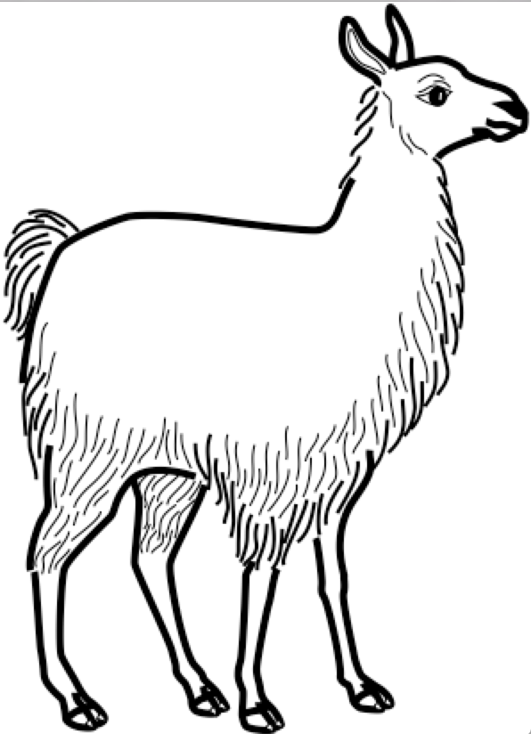
N-Gram Language Models – Two problems
Data sparsity: lack of generalization
What happens “one” n-gram never happens?
Inability to capture long-term dependencies
Each conditional only considers a small window of size n.
Consider “the same stump which had impaled the car of many a guest in the past thirty years and which he refused to have removed”
It is impossible to tell “removed” is likely by looking at the four preceding tokens.

Slide 37
Traditional Solutions
Data Sparsity
Smoothing: add a small constant to avoid 0.
Backoff: try a shorter window.
The most widely used approach: Kneser-Ney smoothing/backoff
KenLM implements the efficient n-gram LM model.

Slide 38
Traditional Solutions
Long-Term Dependency
Increase n: not feasible as the data sparsity worsens.
# of all possible n-grams grows exponentially w.r.t. n:
The data size does not grow exponentially: many never-occurring n-grams.
These two problems are closely related and cannot be tackled well.
To capture long-term dependencies, n must be large.
To address data sparsity, n must be small.
Conflicting goals..

Slide 39
N-Gram Language Models – Two problems
Data sparsity: lack of generalization
What happens “one” n-gram never happens?
Inability to capture long-term dependencies
Each conditional only considers a small window of size n.
Consider “the same stump which had impaled the car of many a guest in the past thirty years and which he refused to have removed”
It is impossible to tell “removed” is likely by looking at the four preceding tokens.

Slide 40
Neural N-Gram Language Model [Bengio et al., 2001]
The first extension of n-gram language models using a neural network
Table Lookup
Table Lookup
Softmax
Sentence
Representation
Extractor*
An arbitrary
sub-graph
Concatenation
Table Lookup

Slide 41
Neural N-Gram Language Model
The first neural language models
Trained using backpropagation and SGD: see Lecture 1
Generalizes to an unseen n-gram
Addresses the issue of data sparsity
How?
Table Lookup
Table Lookup
Softmax
Sentence
Representation
Extractor*
An arbitrary
sub-graph
Concatenation
Table Lookup

Slide 42
Neural N-Gram Language Model
Why does the data sparsity happen?
A “shallow” answer: some n-grams do not occur in the training data, while they do in the test time.
A “slightly deeper” answer: it is difficult to impose token/phrase similarities in the discrete space.
Table Lookup
Table Lookup
Softmax
Sentence
Representation
Extractor*
An arbitrary
sub-graph
Concatenation
Table Lookup

Slide 43
Neural N-Gram Language Model
Why does the data sparsity happen?
Back to the earlier example
Problem:
Observation:
If the LM knew “llama” is a mammal similar to “cat”, “dog” and “deer”, it would be able to guess ”chasing a llama” is as likely as “chasing a cat”, “chasing a dog”, and “chasing a deer”.
Table Lookup
Table Lookup
Softmax
Sentence
Representation
Extractor*
An arbitrary
sub-graph
Concatenation
Table Lookup

Slide 44
Neural N-Gram Language Model
The neural n-gram language model addresses this issue by “learning the similarities” among tokens and phrases in a “continuous vector space”.
In the “continuous vector space”, similar tokens/phrases are nearby: e.g., word2vec [Mikolov et al., 2013; Pennington et al., 2014], doc2vec [Le&Mikolove, 2014], sentence- to-vec [Hill et al., 2016 and ref’s therein]
Then, similar input n-grams lead to similar output:
Table Lookup
Table Lookup
Softmax
Sentence
Representation
Extractor*
An arbitrary
sub-graph
Concatenation
Table Lookup

Slide 45
Neural N-Gram Language Model
Training examples
there are three teams left for qualification.
four teams have passed the first round.
four groups are playing in the field.
Q: how likely is “groups” followed by “three”?
Table Lookup
Table Lookup
Softmax
Sentence
Representation
Extractor*
An arbitrary
sub-graph
Concatenation
Table Lookup
Continuous vector space
three
teams
four
groups

Slide 46
Neural N-Gram Language Model
In practice,
Collect all n-grams from the corpus.
Shuffle all the n-grams to build a training set
Train the neural n-gram language model using stochastic gradient descent on minibatches containing 100-1000 n-grams.
Early-stop based on the validation set.
Report perplexity on the test set.
Table Lookup
Table Lookup
Softmax
Sentence
Representation
Extractor*
An arbitrary
sub-graph
Concatenation
Table Lookup

Slide 47
Increasing the context size – Convolutional Language Models [Kalchbrenner et al., 2015; Dauphin et al., 2016]
Dilated convolution to rapidly increase the window size
Exponential-growth of the window by introducing a multiplicative factor
By carefully selecting the multiplicative factor, no loss in the information.

Slide 48
Increasing the context size – Convolutional Language Models [Kalchbrenner et al., 2015; Dauphin et al., 2016]
Dilated convolution to rapidly increase the window size
Causal convolution: the future tokens cannot be used.
Computation as usual: efficiency
Clever masking of future tokens: causality
Efficient computation + larger context
ByteNet [Kalchbrenner et al., 2015]
PixelCNN, WaveNet, …
Gated Convolutional Language Model [Dauphin et al., 2016]
Softmax

Slide 49
Causal sentence representation and language modelling
Any sentence representation learning method from Lecture 2 could be used as long as it does not break the generative story:
In addition to the feedforward and convolutional n-gram language models, we can use any of the remaining sentence representation.
<bos>
It
explicitly
models
dependencies
<eos>

Slide 50
Infinite context n→∞ – CBoW Language Models
Equivalent to the neural LM after replacing “concat” with “average”
“Averaging” allows the model to consider the infinite large context window.
Extremely efficient, but a weak language model
Ignores the order of the tokens in the context windows.
Any language with a fixed order cannot be modelled well.
Averaging ignores the absolute counts, which may be important:
If the context window is larger, “verb” becomes less likely in SVO languages.

Slide 51
Infinite context n→∞ – Recurrent Language Models [Mikolov et al., 2010]
A recurrent network summarizes all the tokens so far.
Use the recurrent network’s memory to predict the next token.
Efficient online processing of a streaming text:
Constant time per step.
Constant memory throughout forward computation
Useful in practice:
Useful for autocomplete and keyword suggestion.
Scoring partial hypotheses in generation.
Softmax
RNN
RNN
RNN

Slide 52
Infinite context n→∞ – Recurrent Memory Networks [Tran et al., 2016]
The recurrent network solves a difficult problem: compress the entire context into a fixed-size memory vector.
Self-attention does not require such compression but still can capture long-term dependencies.
Combine these two: a recurrent memory network (RMN) [Tran et al., 2016]
RNMT+: a similar, recent extension for neural machine translation
Softmax
Weighting
Function
Summation
RN
RNN
RNN
RNN
RNN
RNN
RNN
RNN
RNN
RNN
RNN
RNN

Slide 53
We learned so far…
What autoregressive language modelling is:
How autoregressive language modelling transforms unsupervised learning into a series of supervised learning:
It is a series of predicting the next token given previous tokens.
How neural language modelling improves upon n-gram language models:
Continuous vector space facilitates generalization to unseen n-grams.
Infinitely large context window
How sentence representation extraction is used for language modelling:
Convolutional language models, recurrent language models and self-attention language models..
Any Questions?

Slide 54
A bit of historical remark
When did neural machine translation start, and where does it fit?

Slide 55
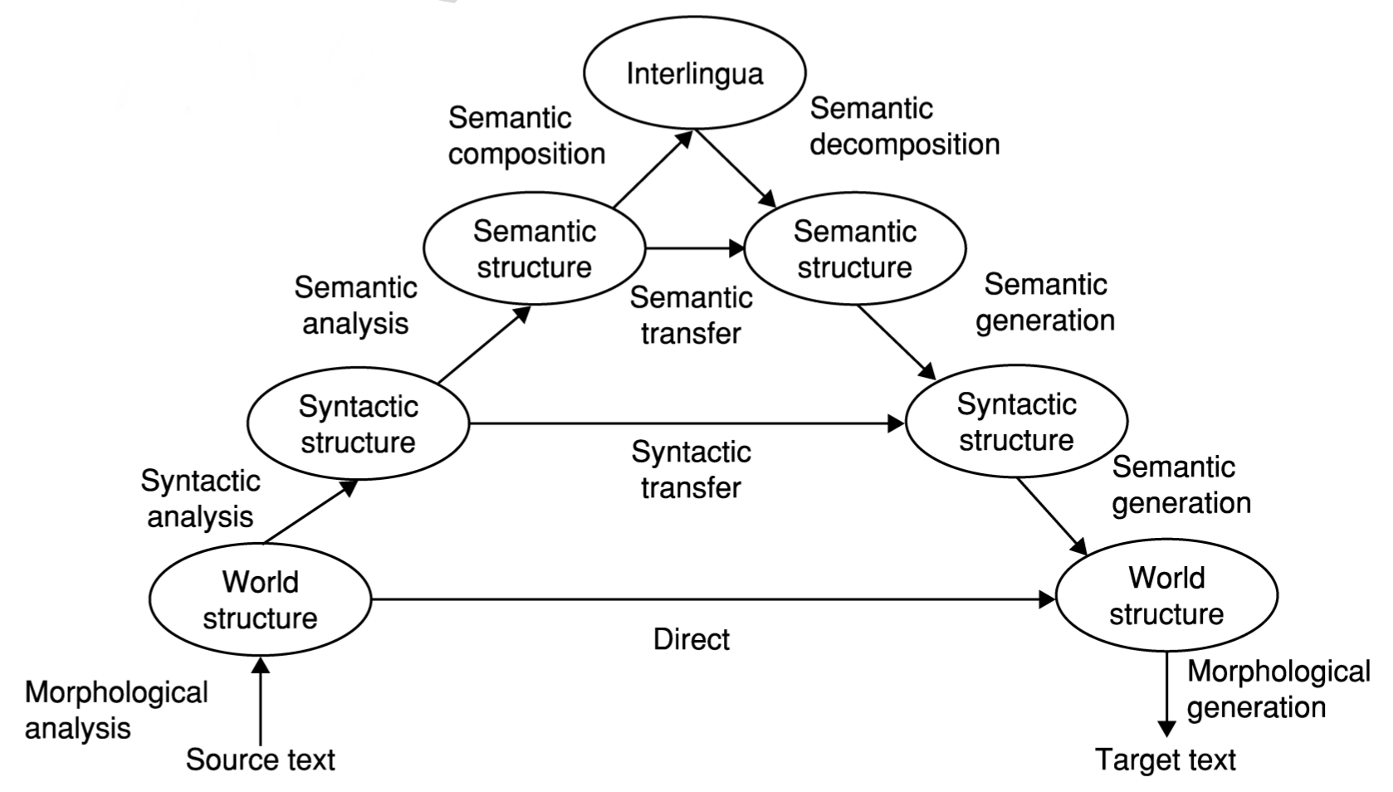
Only if we knew what these were…
Borr, Hovy & Levin (2006)

Slide 56
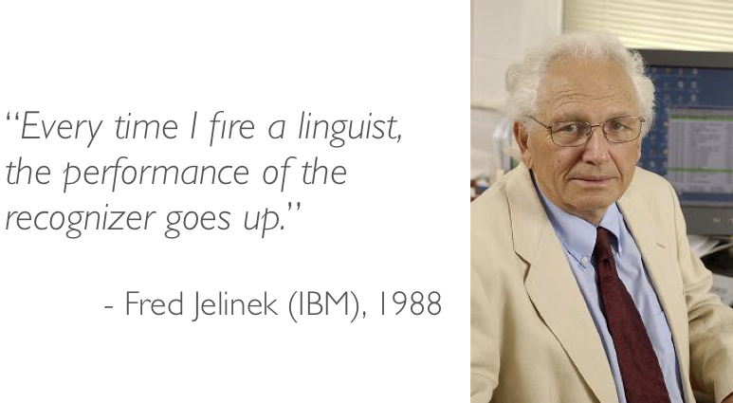
Unfortunately not…
Borr, Hovy & Levin (2006)

Slide 57
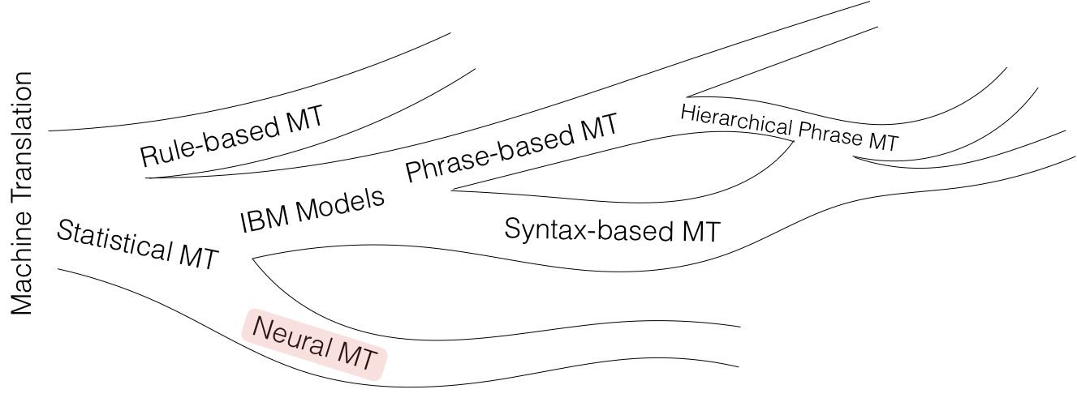

Slide 58
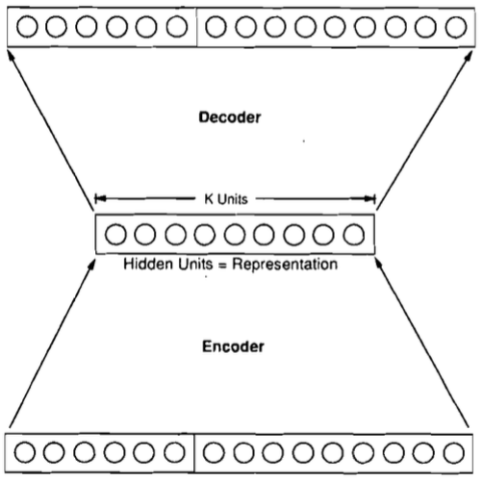
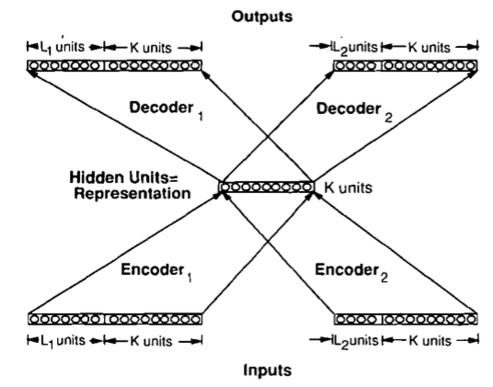
[Allen 1987 IEEE 1st ICNN]
3310 En-Es pairs constructed on 31 En, 40 Es words, max 10/11 word sentence; 33 used as test set
Binary encoding of words – 50 inputs, 66 outputs; 1 or 3 hidden 150-unit layers. Ave WER: 1.3 words
[Chrisman 1992 Connection Science]
Dual-ported RAAM architecture [Pollack 1990 Artificial Intelligence] applied to corpus of 216 parallel pairs of simple En-Es sentences:
Split 50/50 as train/test, 75% of sentences correctly translated!

Slide 59
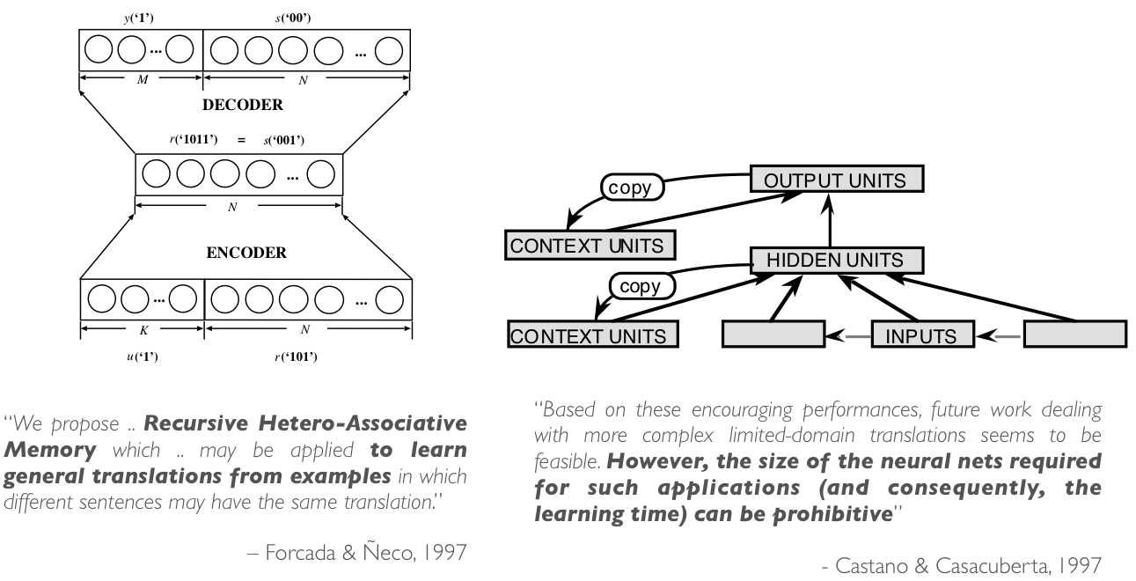
Brief resurrection in 1997

Slide 60
Modern neural machine translation

Slide 61
Machine Translation
Input: a sentence written in a source language
Output: a corresponding sentence in a target language
Problem statement:
Supervised learning: given the input sentence, output its translation
Compute the conditional distribution over all possible translation given the input
We have already learned every necessary ingredient for building a full neural machine translation system.

Slide 62
Token Representation – One-hot Vectors
Build source and target vocabularies of unique tokens
For each of source and target languages,
Tokenize: separate punctuations, normalize punctuations, … e.g., “I’m going” => (“I”, “’m”, “going”), replace ‘, ’, `, into “`”, … use Spacy.io, NLTK or Moses’ tokenizer.
Subword segmentation: segment each token into a sequence of subwords e.g., “going” => (“go”, “ing”), use BPE [Sennrich et al., 2015]
Collect all unique subwords, sort them by their frequencies (descending) and assign indices.
Transform each subword token into a corresponding one-hot vector.*
* Of course, don’t do it offline. Transform them online.

Slide 63
Encoder – Source Sentence Representation
Encode the source sentence into a set of sentence representation vectors
# of encoded vectors is proportional to the source sentence length: often same.
Recurrent networks have been widely used [Cho et al., 2014; Sutskever et al., 2014], but CNN [Gehring et al., 2017; Kalchbrenner&Blunsom, 2013] and self-attention [Vaswani et al., 2017] are used increasingly more often.
We do not want to collapse them into a single vector.
Collapsing often corresponds to information loss.
Increasingly more difficult to encode the entire source sentence into a single vector, as the sentence length increases [Cho et al., 2014b].
We didn’t know initially until [Bahdanau et al., 2015].

Slide 64
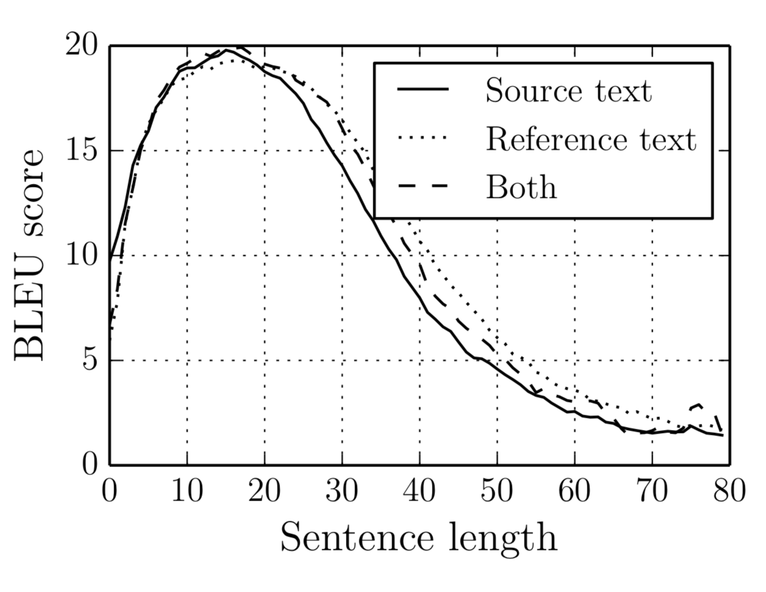
Encoder – Source Sentence Representation
Encode the source sentence into a set of sentence representation vectors
We do not want to collapse them into a single vector.
Increasingly more difficult to encode the entire source sentence into a single vector, as the sentence length increases [Cho et al., 2014b].

Slide 65
Encoder – Source Sentence Representation
Encode the source sentence into a set of sentence representation vectors
We do not want to collapse them into a single vector.
Increasingly more difficult to encode the entire source sentence into a single vector, as the sentence length increases [Cho et al., 2014b].
When collapsed, the system fails to translate a long sentence correctly.
Source: An admitting privilege is the right of a doctor to admit a patient to a hospital or a medical centre to carry out a diagnosis or a procedure, based on his status as a health care worker at a hospital.
When collapsed: Un privilège d’admission est le droit d’un médecin de reconnaître un patient à l’hôpital ou un centre médical d’un diagnostic ou de prendre un diagnostic en fonction de son état de santé.
The system translates reasonable up to a certain point, but starts drifting away.

Slide 66
Decoder – Language Modelling
Autoregressive Language modelling with an infinite context n→∞
Larger context is necessary to generate a coherent sentence.
Semantics could be largely provided by the source sentence, but syntactic properties need to be handled by the language model directly.
Recurrent networks, self-attention and (dilated) convolutional networks
Causal structure must be followed.
See Lecture 3.
Conditional Language modelling
The context based on which the next token is predicted is two-fold

Slide 67
Decoder – Conditional Language Modelling
Conditional Language modelling
The context based on which the next token is predicted is two-fold.
Supervised learning: T input-output training pairs per sentence
Input: the entire source sentence and the preceding target tokens
Output: the next token

Slide 68
Decoder – Conditional Language Modelling
Conditional Language modelling
?
Softmax
Source Sentence Representation
Target Sentence Representation

Slide 69
RNN Neural Machine Translation [Bahdanau et al., 2015]
Source sentence representation
A stack of bidirectional RNN’s
The extracted vector at each location is a context-dependent vector representation.
?
Softmax
Source Sentence Representation
Concat
RNN
RNN
RNN
Target Sentence Representation
RNN
RNN
RNN

Slide 70
RNN Neural Machine Translation [Bahdanau et al., 2015]
?
Target prefix representation
A unidirectional recurrent network
Compression of the target prefix
Summarizes what has been translated so far
Softmax
Source Sentence Representation
RNN
RNN
RNN
Target Sentence Representation

Slide 71
RNN Neural Machine Translation [Bahdanau et al., 2015]
?
Attention mechanism
Which part of the source sentence is relevant for predicting the next target token?
Recall self-attention from Lecture 2
Softmax
Source Sentence Representation
Summation
Target Sentence Representation
Weighting
Function
RN

Slide 72
RNN Neural Machine Translation [Bahdanau et al., 2015]
?
Attention mechanism
Which part of the source sentence is relevant for predicting the next target token?
Time-dependent source context vector
Softmax
Source Sentence Representation
Summation
Weighting
Function
RN
Target Sentence Representation

Slide 73
RNN Neural Machine Translation [Bahdanau et al., 2015]
Fuse the source context vector and target prefix vector
Combines and into a single vector
Weighting
Function
Summation
Softmax
Source Sentence Representation
An arbitrary
sub-graph
RN
Target Sentence Representation

Slide 74
RNN Neural Machine Translation
Conceptual process
Encode: read the entire source sentence to know what to translate
Attention: at each step, decide which source token(s) to translate next
Decode: based on what has been translated and what need to be translated, predict the next target token.
Repeat 2-3 until the <end-of-sentence> special token is generated.

Slide 75
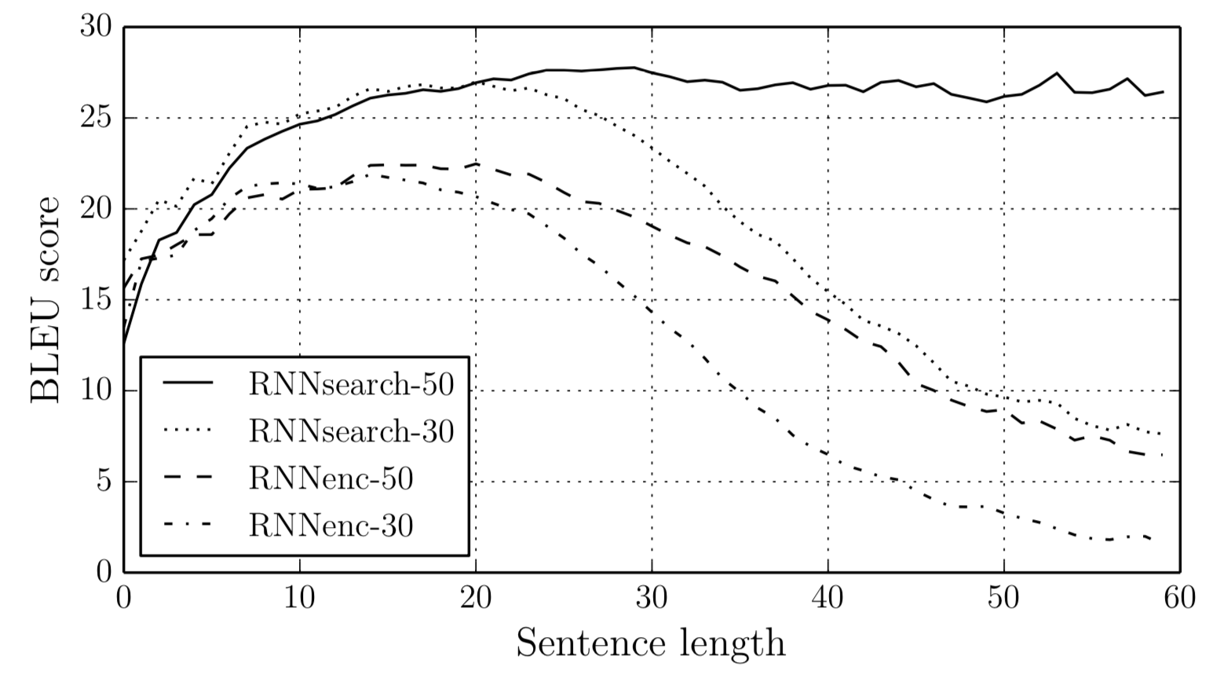
RNN Neural Machine Translation
The model is not pressured to compress the entire source sentence into a single, fixed-size vector:
Greatly improves the translation quality, especially of long sentences.
Much more efficient: less parameters are necessary.
Bahdanau et al. [2015] showed for the first time the machine translation purely based on neural networks could be as good as then-state-of-the-art alternatives (e.g., PBMT).

Slide 76
RNN Neural Machine Translation
Source: An admitting privilege is the right of a doctor to admit a patient to a hospital or a medical centre to carry out a diagnosis or a procedure, based on his status as a health care worker at a hospital.
When collapsed: Un privilège d’admission est le droit d’un médecin de reconnaître un patient à l’hôpital ou un centre médical d’un diagnostic ou de prendre un diagnostic en fonction de son état de santé.
RNNSearch: Un privilège d’admission est le droit d’un médecin d’admettre un patient à un hôpital ou un centre médical pour effectuer un diagnostic ou une procédure, selon son statut de travailleur des soins de santé à l’hôpital.

Slide 77
RNN Neural Machine Translation
Source: An admitting privilege is the right of a doctor to admit a patient to a hospital or a medical centre to carry out a diagnosis or a procedure, based on his status as a health care worker at a hospital.
When collapsed: Un privilège d’admission est le droit d’un médecin de reconnaître un patient à l’hôpital ou un centre médical d’un diagnostic ou de prendre un diagnostic en fonction de son état de santé.
RNNSearch: Un privilège d’admission est le droit d’un médecin d’admettre un patient à un hôpital ou un centre médical pour effectuer un diagnostic ou une procédure, selon son statut de travailleur des soins de santé à l’hôpital.

Slide 78
RNN Neural Machine Translation
Sensible alignment between source and target tokens
Capture long-range reordering/dependencies
Without strong supervision on the alignment
Weakly supervised learning
(Bahdanau et al., 2015; Jean et al., 2015)

Slide 79
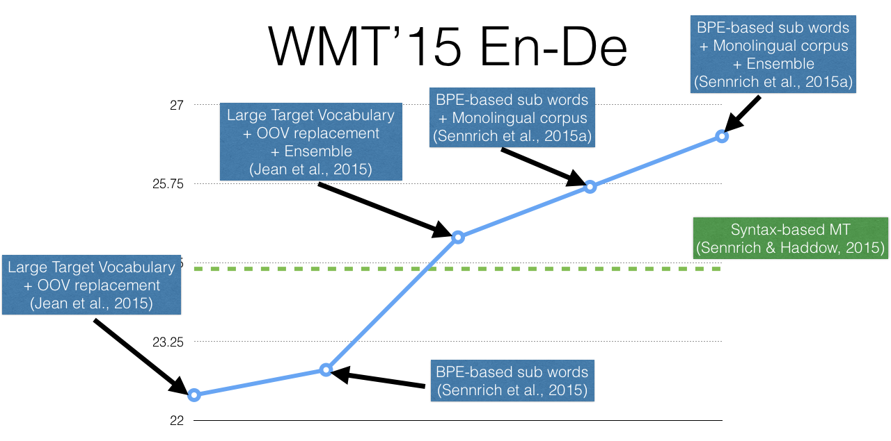
1 Year

Slide 80
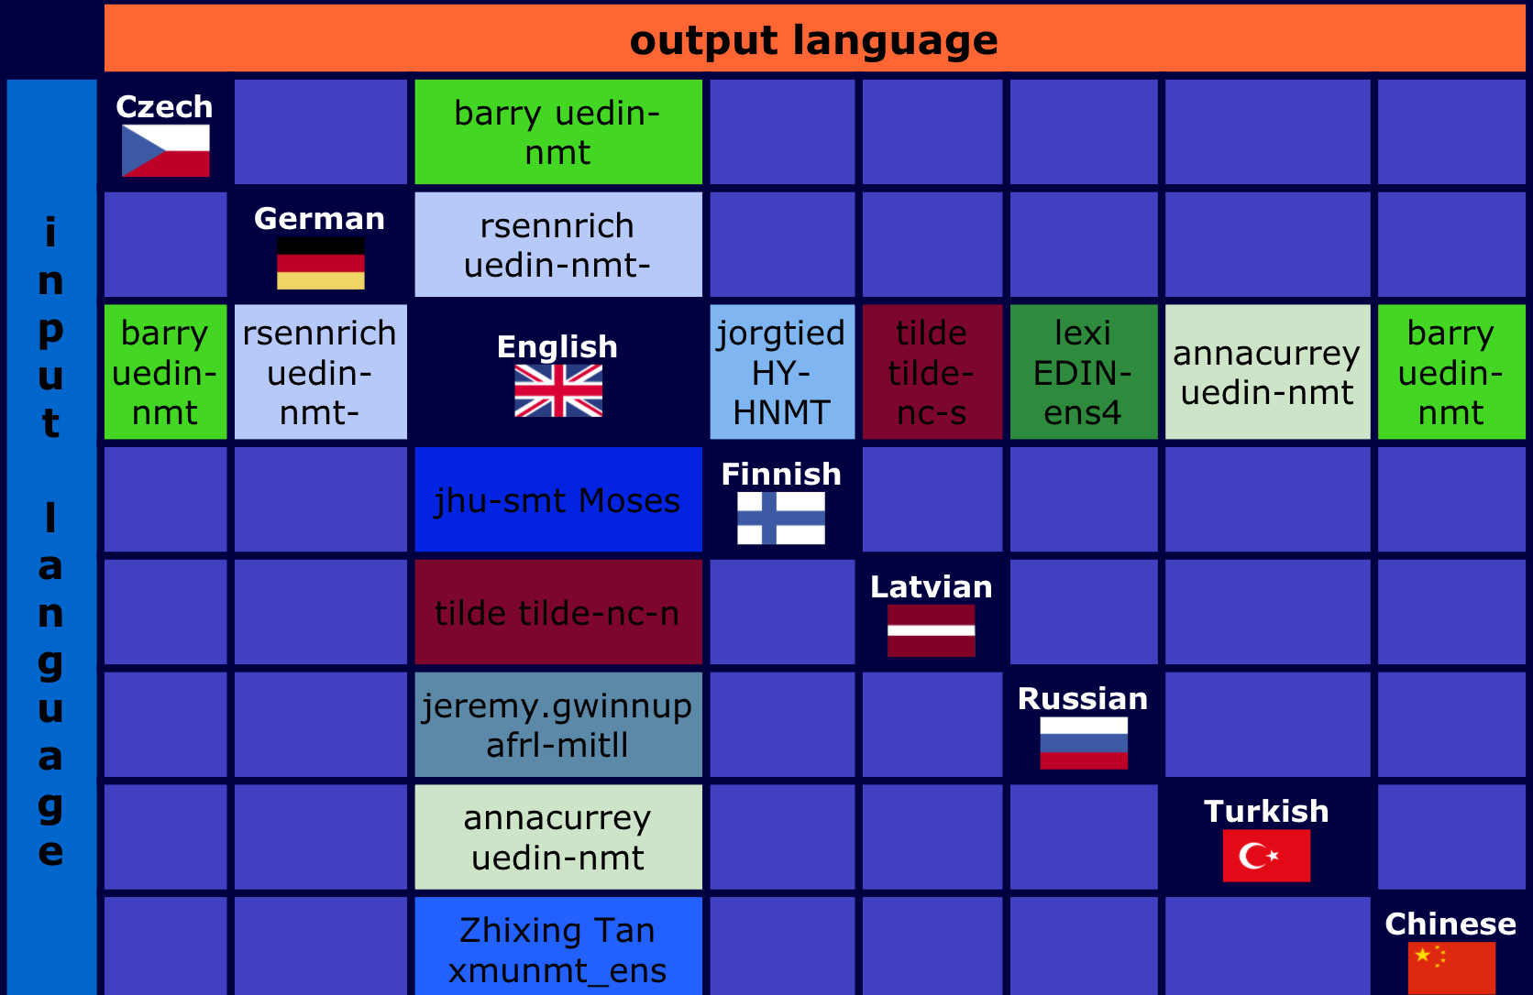
WMT 2017: news translation task

Slide 81
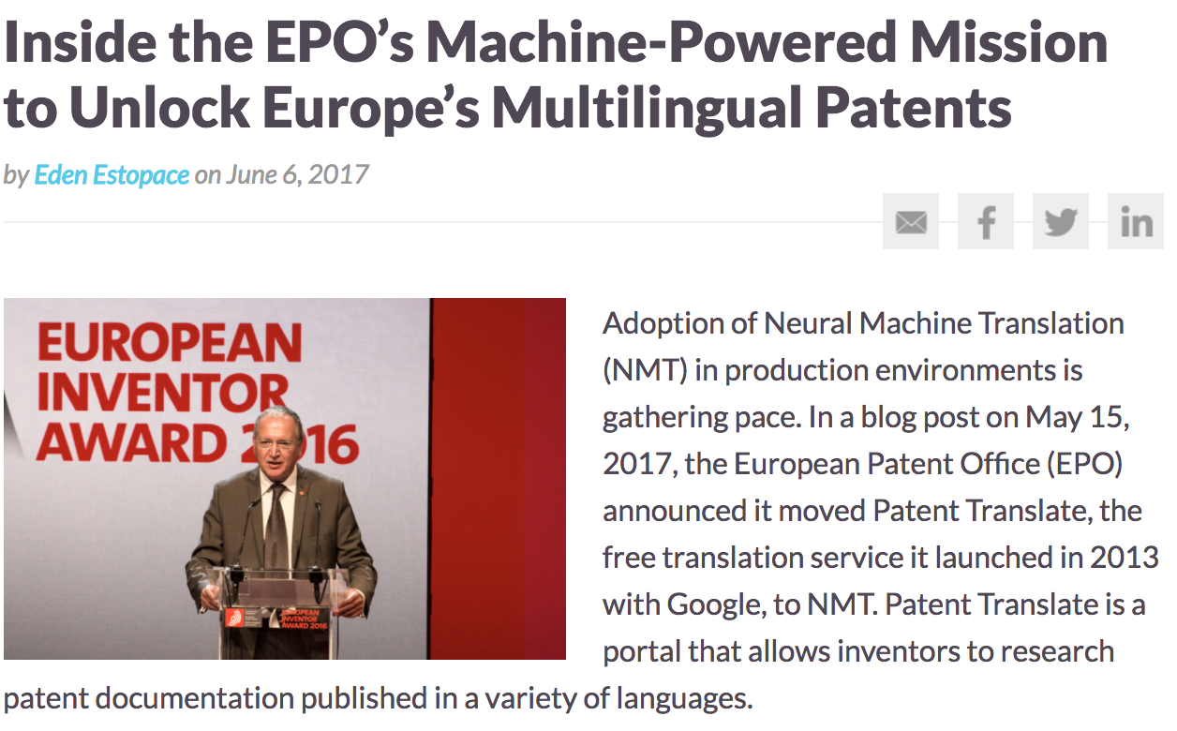
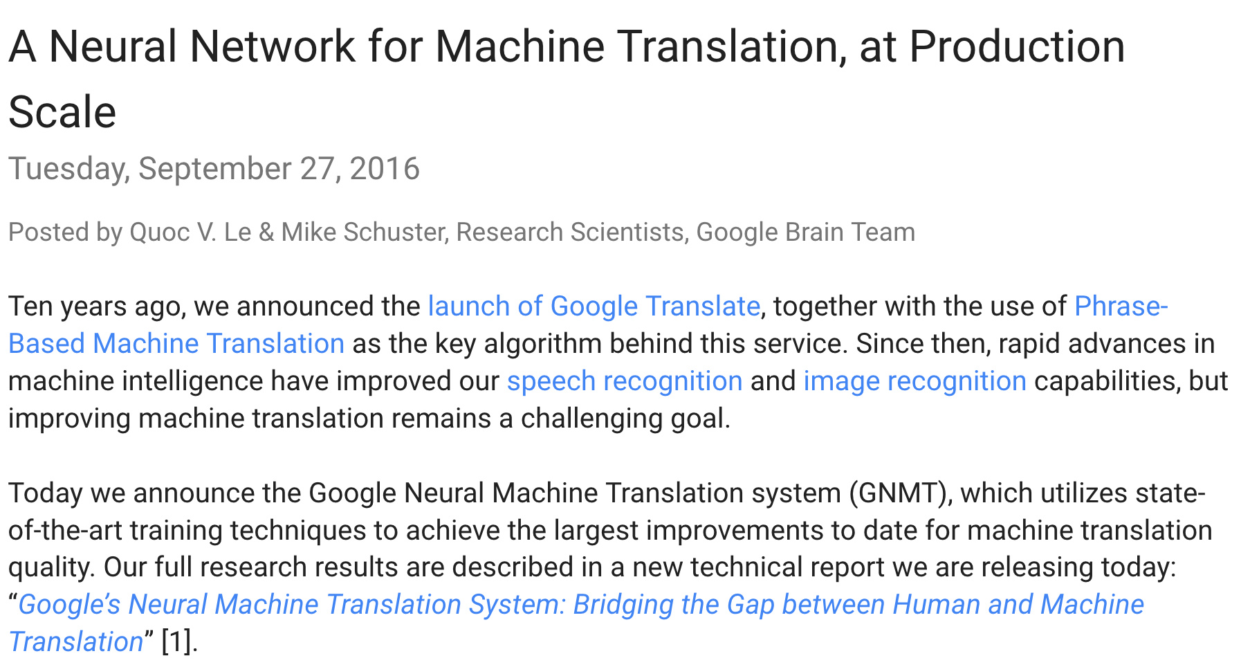

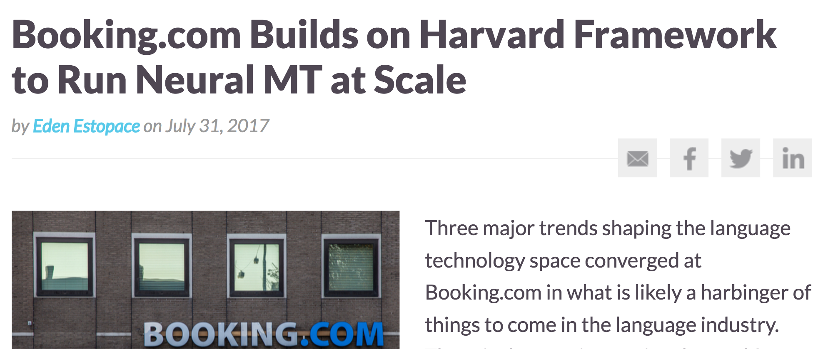
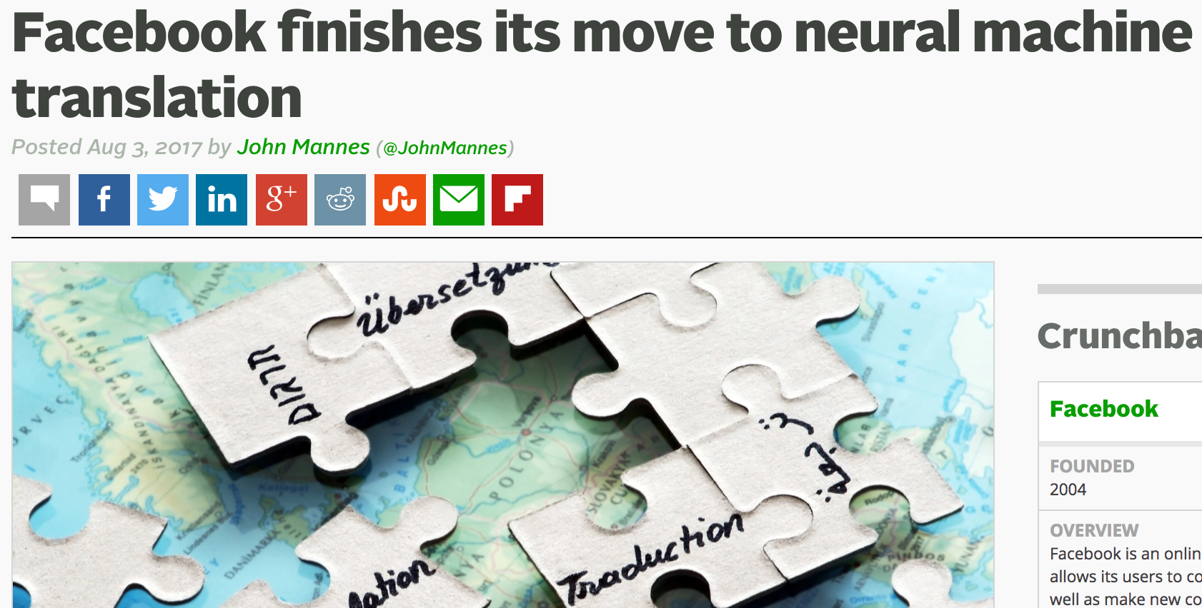
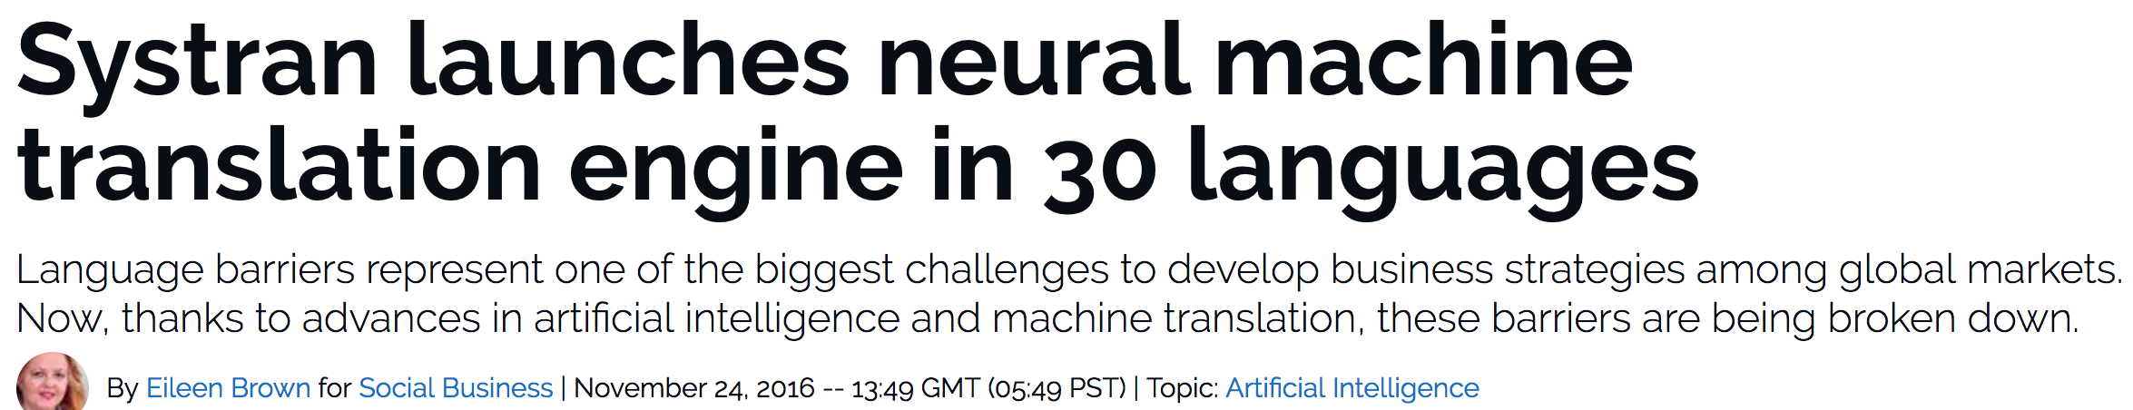
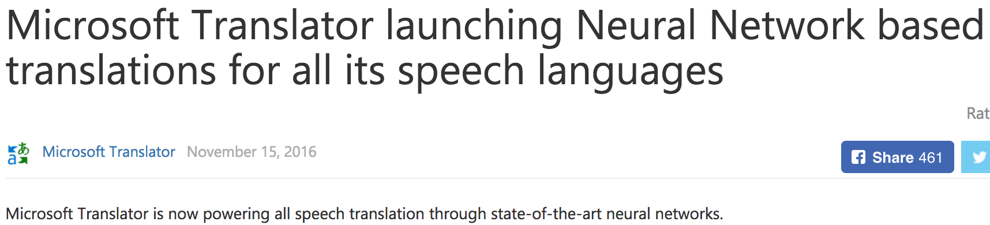

Slide 82

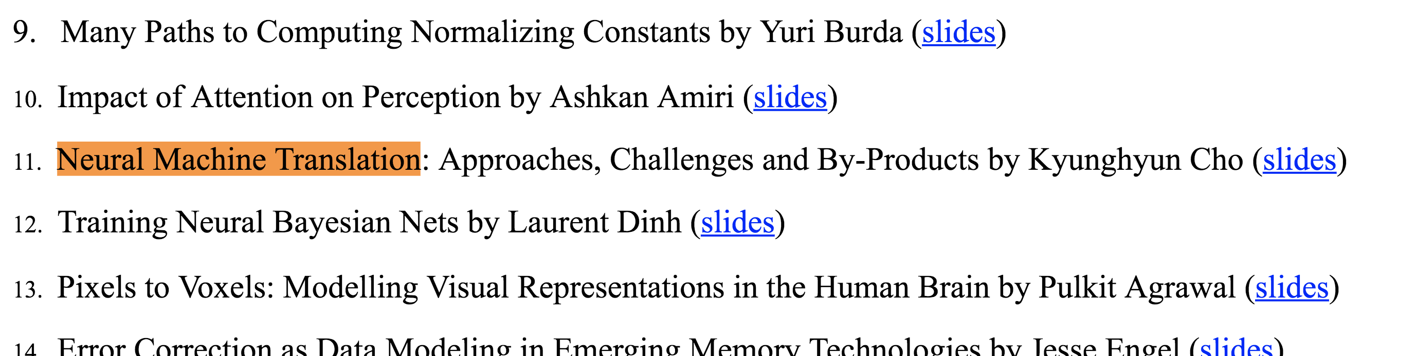
When was “neural machine translation” coined?

Slide 83
In practice,
Many excellent open-source packages exist:
Nematus https://github.com/EdinburghNLP/nematus
Compute backend: TensorFlow (originally Theano)
Used to build state-of-the-art translation systems for WMT’16 and WMT’17.
Supported by U. Edinburgh (Rico Sennrich’s group)
OpenNMT-py https://github.com/OpenNMT/OpenNMT-py
Compute backend: PyTorch (originally Lua-Torch)
Implements latest architectures and algorithms
Supported by Harvard NLP (Sasha Rush’s group)
FairSeq https://github.com/facebookresearch/fairseq
Compute backend: PyTorch
Focuses on the convolutional seq2seq
Supported by Facebook AI Research
Sockeye https://github.com/awslabs/sockeye
Compute backend: MXNet
Supported by Amazon

Slide 84
In practice,
Many new architectures are being proposed constantly
Convolutional sequence-to-sequence models [Gehring et al., 2017]
Encoder: CNN-based sentence representation
Decoder: CNN-based conditional language model
Transforms [Vaswani et al., 2017]
Encoder: Self-attention based sentence representation
Decoder: Self-attention based conditional language model
It has been four years only, and a long road lies ahead…

Slide 85
Further application – machine reading
Input: a paragraph + a question
Output: the position of the answer in the paragraph
Paragraph
Question
In meteorology, precipitation is any product of the condensation of atmospheric water vapor that falls under gravity. The main forms of precipitation include drizzle, rain, sleet, snow, graupel and hail... Precipitation forms as smaller droplets coalesce via collision with other rain drops or ice crystals within a cloud. Short, in- tense periods of rain in scattered locations are called “showers”.
What causes precipitation to fall?
SQuAD from [Rajpurkar et al., 2017]

Slide 86
Further application – machine reading
Encode the paragraph into a set of continuous vectors
e.g., use a bidirectional recurrent network.
Encode the question into a single, fixed-size vector
e.g., use a self-attention network followed by averaging.
Compare each token in the paragraph against the question using the RN module:
Turn the scores into a Categorical distribution using softmax.
Train it by maximizing the log-probability of the correct answer.
Nothing really changes other than the network architecture (DAG)

Slide 87
We have so far learned…
What machine translation is:
It maps a sentence in a source language into its translation in a target language.
What neural machine translation is:
A single neural network is used to approximate the entire translation process.
How to build an RNN neural machine translation system:
Encoder: a bidirectional RNN
Decoder: a unidirectional RNN coupled with the attention mechanism
Any Questions?

Slide 88
From here on…
I will cover two recent research projects:
Real-time translation
Non-Autoregressive Neural Machine Translation by Iterative Refinement

Slide 89
Real-Time Translation Learning to Decode
Kyunghyun Cho
New York University
Courant Institute (Computer Science) and Center for Data Science
Facebook AI Research
Jiatao Gu, Victor Li, Graham Neubig, Kyunghyun Cho.
Learning to translate in real-time with neural machine translation. EACL’17.

Slide 90
Decoding from a recurrent language model

Slide 91
Decoding (0) – Exhaustive Search
Simple and exact decoding algorithm
Score each and every possible translation
Pick the best one

Slide 92
Decoding (1) – Ancestral Sampling
Efficient, unbiased sampling
One symbol at a time from
Until
The
cat
sat
…

Slide 93
Decoding (1) – Ancestral Sampling
Efficient, unbiased sampling
One symbol at a time from
Until
Repeat this procedure for times:
Choose
Pros:
Unbiased (asymptotically exact)
Cons:
High variance
Pretty inefficient

Slide 94
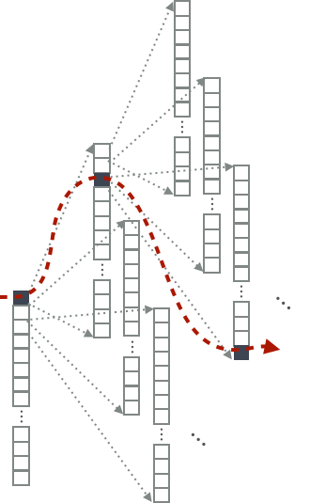
Decoding (2) – Greedy Search
Efficient, but heavily suboptimal search
Pick the most likely symbol each time
Until
Pros:
Super-efficient: both computation and memory
Cons:
Heavily suboptimal

Slide 95
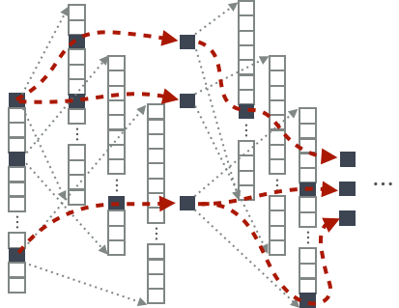
Decoding (3) – Beam Search
Pretty, but not quite efficient
Maintain K hypotheses at a time
Expand each hypothesis
Pick top-K hypotheses from the union where

Slide 96
Decoding (3) – Beam Search
Asymptotically exact, as
Not necessarily monotonic improvement w.r.t.
K is selected to maximize the translation quality on a validation set.

Slide 97
Decoding
English to Czech Translation: 12m training sentence pairs
^{Cho (2016)}

Slide 98
Inference is difficult and expensive (1)
State space grows exponentially w.r.t. the (max) length of a sentence
possible sentences with ,
No obvious way to reduce the search space: non-Markovian model
Cheap, approximate search is often too approximate
Greedy decoding: cheap, approximate search
Noisy, parallel approximate decoding (NPAD)
Beam search: expensive, approximate search
(Cho, 2016 horribly rejected from NIPS)

Slide 99
Inference is difficult and expensive (2)
Is this what we want?
Decoding objectives are not known in advance
MT for real-time conversation: quality ↑ vs. delay ↓
MT for K-12 students: quality ↑ vs. text difficulty ↓
On-device translation: quality ↑ vs. computational complexity ↓
Even if so, little or no data available
Simultaneous interpretation: almost none with time stamps [He et al., 2016 NAACL]
Parallel corpora with controlled levels of difficulty: none
What can we do about it?

Slide 100
Learning to decode

Slide 101

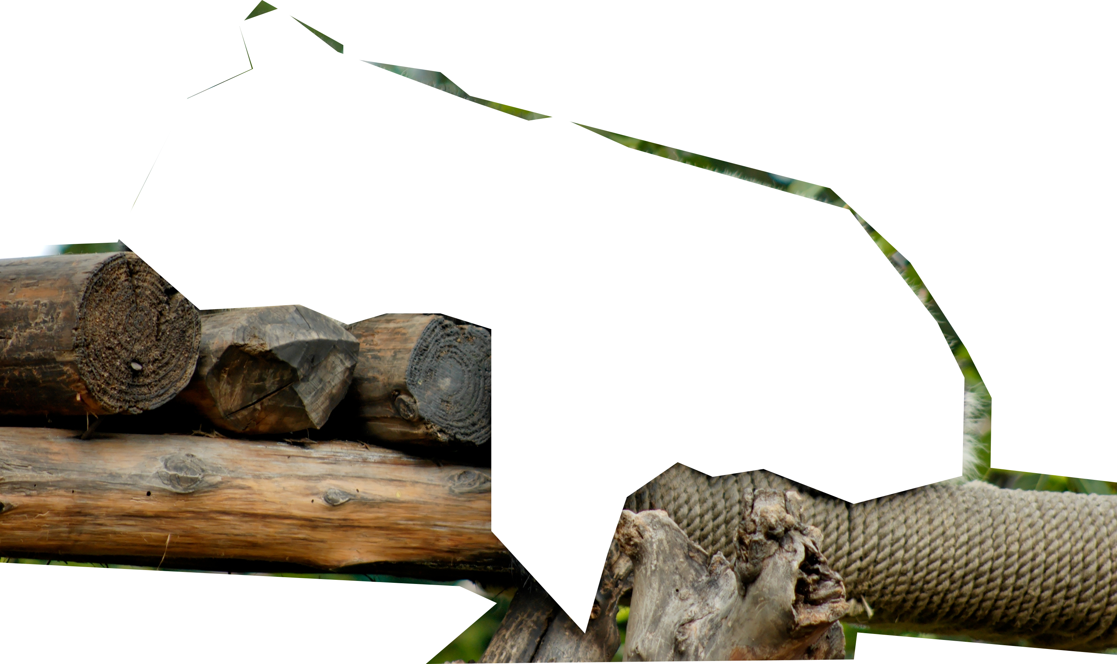
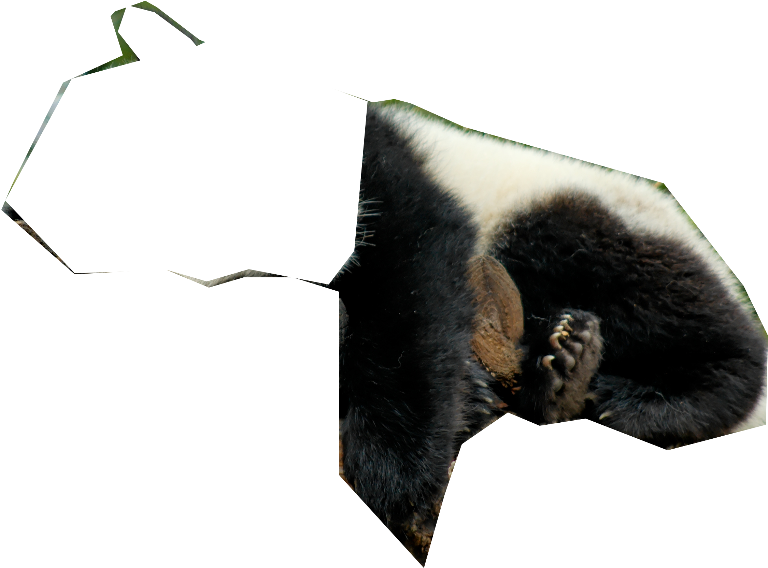
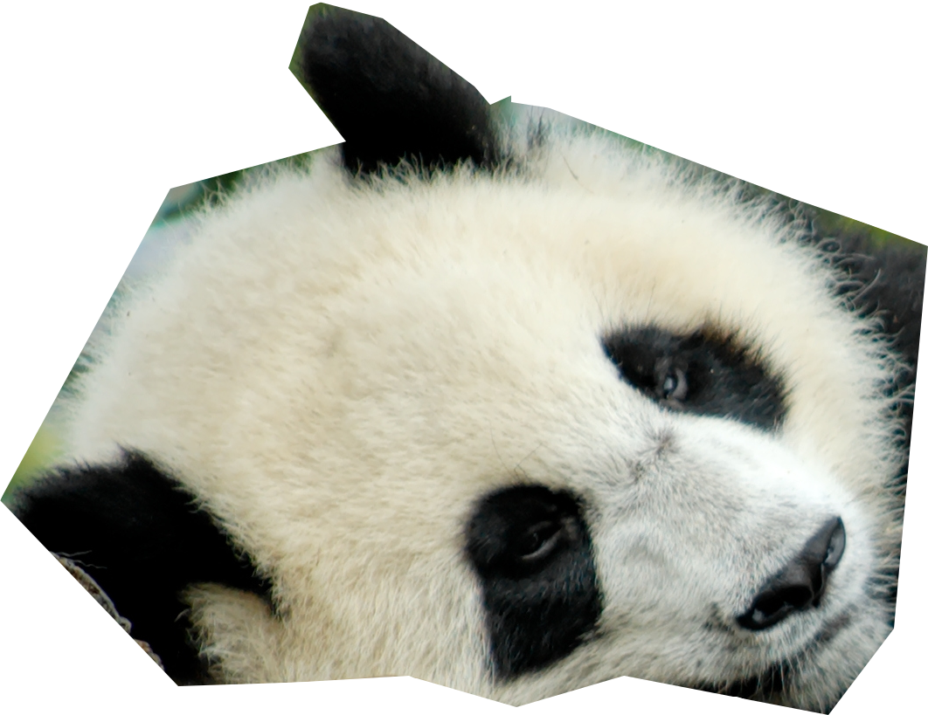
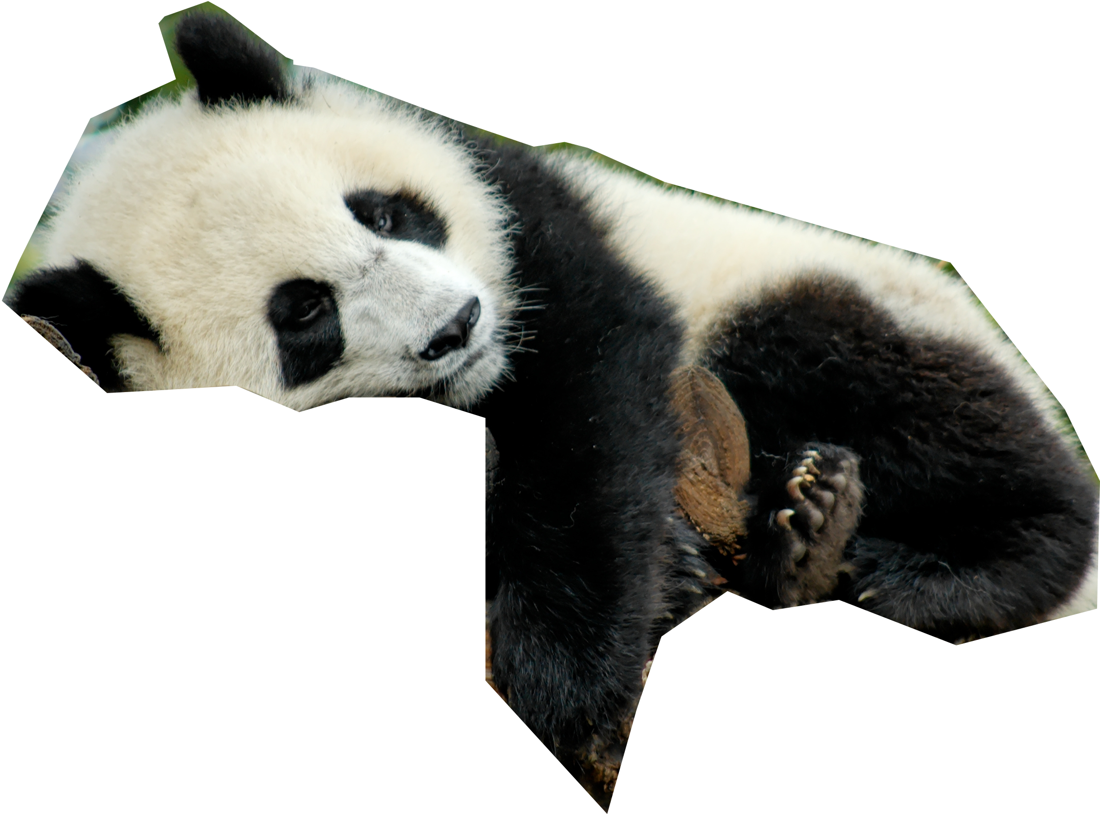


Neural network = Forgetting machine
Panda?
- Yes
- No
A deep neural net iteratively disentangles relevant and irrelevant features
Irrelevant features are discarded as information propagates
In other words, hidden layers contain rich info beyond the task!

Slide 102
Exploiting the hidden activation
What is captured by the hidden layers?
Deep Visualization: Edges/corners → textures → object parts → entire objects [Zeiler&Fergus, 2014 ECCV; Yosinski et al., 2016 DL; and many more]
Long-range dependency: closing brackets, agreement, … [Karpathy et al., 2015 arXiv; Tran et al., 2016 NAACL]
Sentiment! [Radford et al., 2017 OpenAI]
Fairly limited understanding especially with text
Why?
Hidden activations of a small recurrent language model

Slide 103
Trainable Decoding (1)
A conditional recurrent neural net defines an environment
State:
Previous hidden state
Current input
Source context
Action: any modification
Next input
Source
Reward: arbitrary

Slide 104
Trainable Decoding (2)
A conditional recurrent neural net defines an environment
A decoder is an agent:
Observes the state via
Acts by selecting
Limited, because it doesn’t exploit rich info captured in
Can we extend it by training a neural network decoder?

Slide 105
Yes, we can!
Simultaneous Translation
Jiatao Gu, Kyunghyun Cho, Victor OK Li. Trainable greedy decoding for neural machine translation. EMNLP 2017
Trainable Greedy Decoding
Jiatao Gu, Graham Neubig, Kyunghyun Cho, Victor OK Li. Learning to translate in real-time with neural machine translation. EACL 2017.
Yun Chen, Victor Li, Sam Bowman, Kyunghyun Cho. A Stable and Effective Learning Strategy for Trainable Greedy Decoding. (under review)

Slide 106
Simultaneous Translation (1)
Inspired by simultaneous interpretation
Source words arrive one at a time
Translation starts before the complete sentence arrives
Objective: quality ↑ delay ↓
Interpreters at the Nuremberg Trial (1945-1946)
https://www.pri.org/stories/2014-09-29/how-do-all-those-leaders-un-communicate-all-those-languages

Slide 107
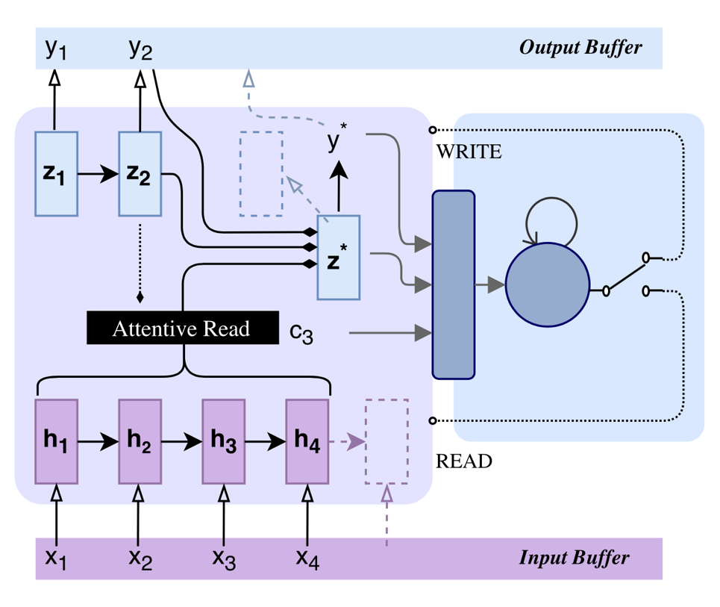
Simultaneous Translation (2)
Decoding
Start with a well-trained NMT
A simultaneous decoder intercepts and interprets the incoming signal
The simultaneous decoder forces the pretrained model to either
output a target symbol, or
wait for the next source symbol
Learning
Trade-off between delay and quality
Policy gradient (REINFORCE)
[Gu, Neubig, Cho & Li, EACL 2017]

Slide 108
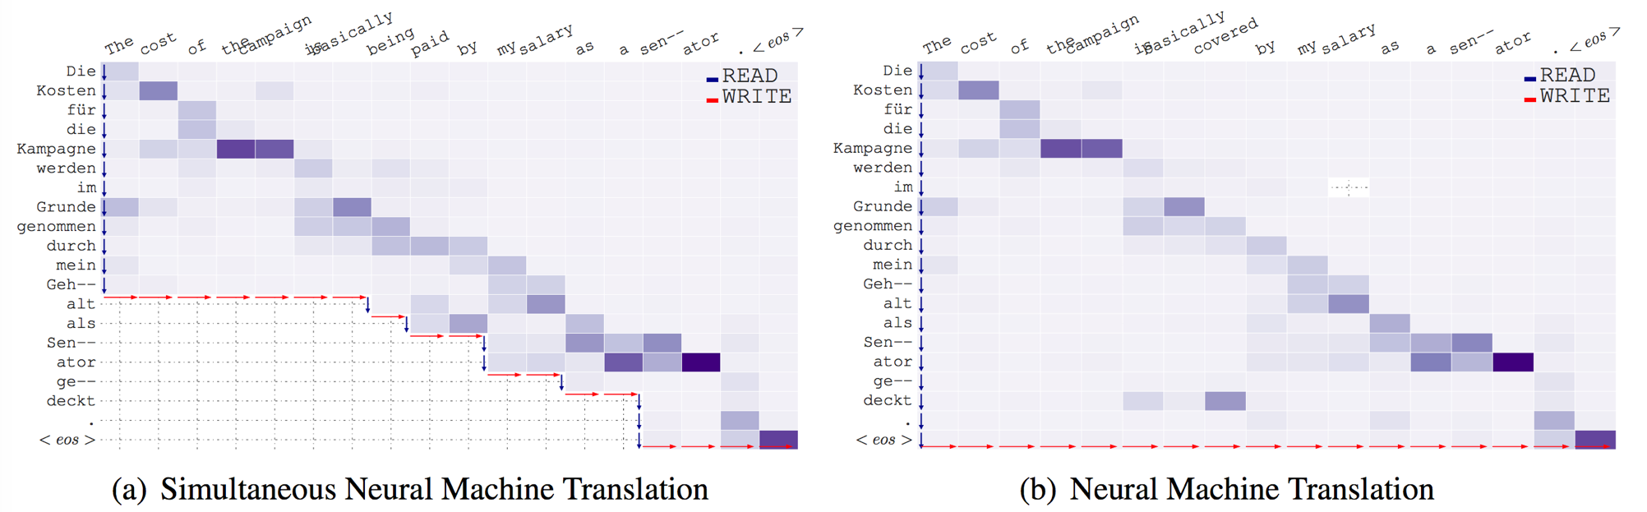
Simultaneous Translation (3)
[Gu, Neubig, Cho & Li, EACL 2017]

Slide 109
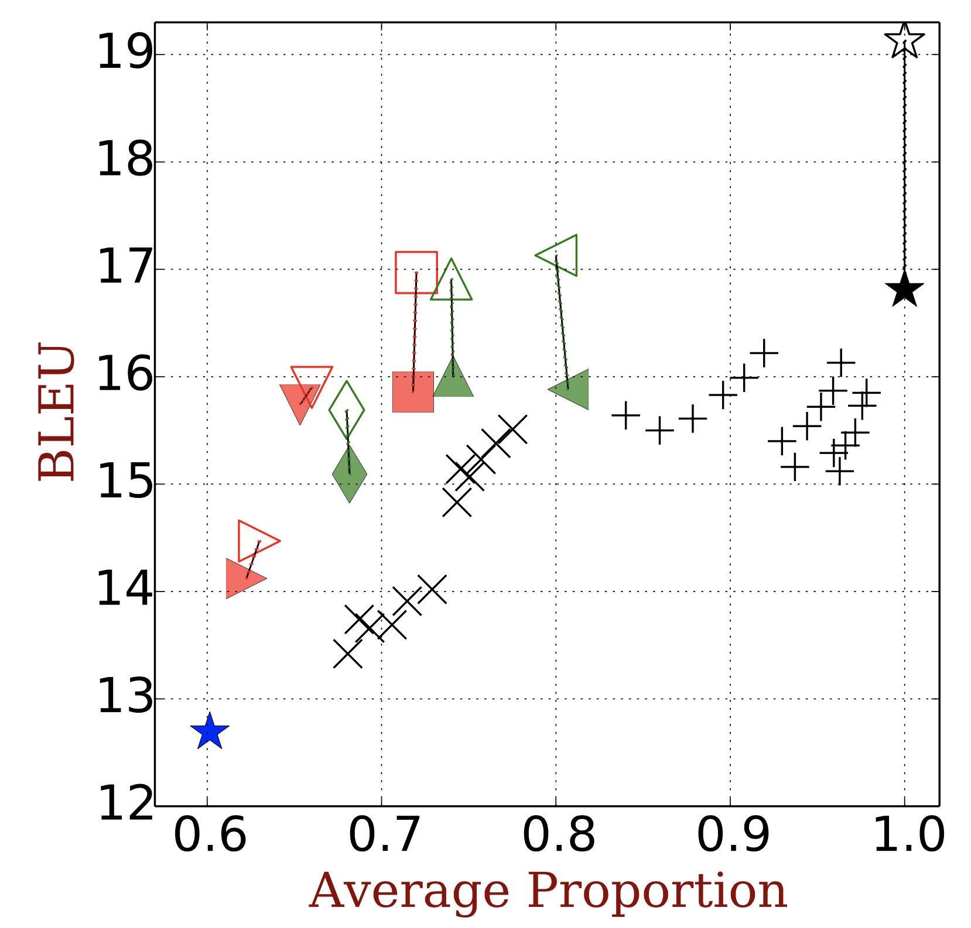
Simultaneous Translation (4)
⭑consecutive translation
⭑word-by-word translation
✚𝗫 simultaneous translation without using
◾️▲simultaneous translation (trainable decoding)
Better simultaneous translation by exploiting the rich info captured by the hidden state
Desired
[Cho & Esipova, 2016 horribly rejected from EMNLP]
[Gu, Neubig, Cho & Li, EACL 2017]

Slide 110
Non-Autoregressive Translation via Iterative Refinement
Beyond autoregressive neural sequence modelling
Jason Lee, Elman Mansimov and Kyunghyun Cho. Deterministic Non-Autoregressive Neural Sequence Modeling by Iterative Refinement. 2018 (under review)

Slide 111
Neural autoregressive sequence modeling
Decoding is problematic
Exact decoding is intractable
Decoding is inherently sequential
y1
y2
y3
y4
X

Slide 112
Neural non-autoregressive sequence modeling
Conditional independence among ’s
Exact decoding is tractable
Decoding is highly parallelizable
y1
y2
y3
y4
X

Slide 113
Neural non-autoregressive sequence modeling
Too good to be true: dependencies must be modelled somehow
Introduce a set of latent variables [Gu et al., 2018 ICLR]
y1
y2
y3
y4
Z
X

Slide 114
Neural non-autoregressive sequence modeling
Repetition as a latent variable [Gu et al., 2018 ICLR]
Each latent variable : # of repetitions of the input symbol
=1
=3
z1
z2
y1
y2
y3
y4
x1
x2
x1
x2
x2
x2

Slide 115
Neural non-autoregressive sequence modeling
Repetition as a latent variable [Gu et al., 2018 ICLR]
Each latent variable : # of repetitions of the input symbol
Monte Carlo approximation with rescoring
,
Pick with the high score by another model.
z1
z2
y1
y2
y3
y4
x1
x2
x1
x2
x2
x2

Slide 116
Neural non-autoregressive sequence modeling
Repetition as a latent variable [Gu et al., 2018 ICLR]
Each latent variable : # of repetitions of the input symbol
For training: use an auxiliary task to train
Word alignment models: use fast_align [Dyer et al., 2013]
z1
z2
y1
y2
y3
y4
x1
x2
x1
x2
x2
x2

Slide 117
Neural non-autoregressive sequence modeling
First convincing result!! [Gu et al., 2018 ICLR]
IWSLT’16 En→De
Non-Autoregressive? | Decoding | BLEU | Sentence Latency (ms)
No | Greedy | 28.89 | 408ms
 | Beam search (4) | 29.70 | 607ms
Yes | argmax | 25.20 | 39ms
 | MC+Rescoring (10) | 27.44 | 79ms
 | MC+Rescoring (100) | 28.16 | 257ms

Slide 118
Non-autoregressive modeling by iterative refinement [Lee, Mansimov & Cho, 2018]
What are these latent variables?
We impose that latent variables share the output semantics
They share the same vocabulary
Multiple layers of the latent variables
Shared conditional distributions

Slide 119
Non-autoregressive modeling by iterative refinement
Generative story: Iterative refinement
Refine*: Generate an intermediate translation given a previous translation and the source sentence
Repeat 1 for iterations (or until convergence)
y1
y2
y3
y4
y1
y2
y3
y4
X
* As the latent variables share the semantics with the output, we can use Z and Y exchangingly.

Slide 120
Non-autoregressive modeling by iterative refinement
Training 1: end-to-end training
The output of each iteration is encouraged to be the correct answer
y₁*
y₂*
y₃*
y₄*
y₁*
y₂*
y₃*
y₄*
CE
CE
CE
CE
CE
CE
CE
CE
y1
y2
y3
y4
y1
y2
y3
y4
X

Slide 121
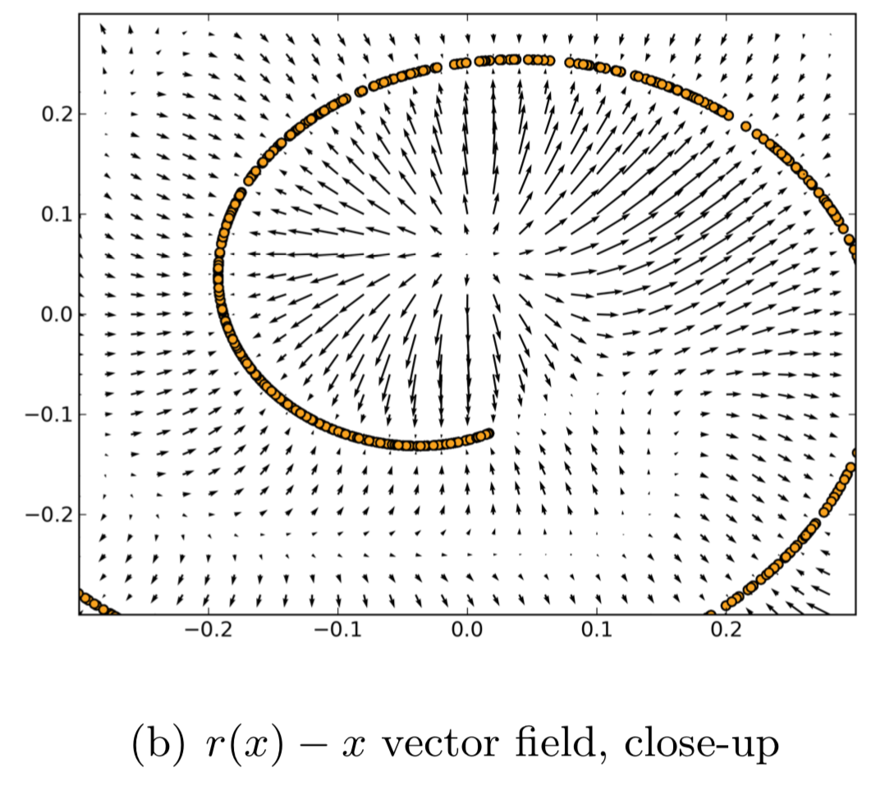
Non-autoregressive modeling by iterative refinement
Training 2: Conditional denoising autoencoder
A denoising autoencoder learns to hill climb [Vincent, 2011; Alain & Bengio, 2013]

Slide 122
Non-autoregressive modeling by iterative refinement
Training 2: Conditional denoising autoencoder
A denoising autoencoder learns to hill climb [Vincent, 2011; Alain & Bengio, 2013]
y₁*
y₂*
y₃*
y₄*
Corruption Function C
CE
CE
CE
CE
z1
z2
z3
z4
y1
y2
y3
y4
X

Slide 123
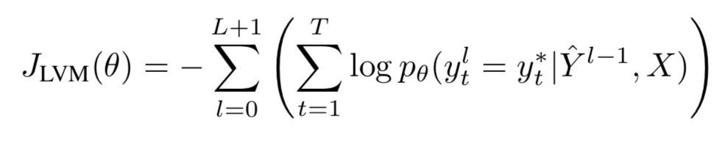
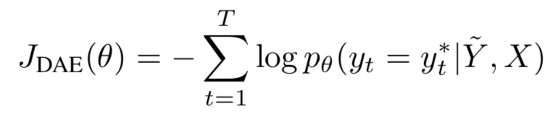
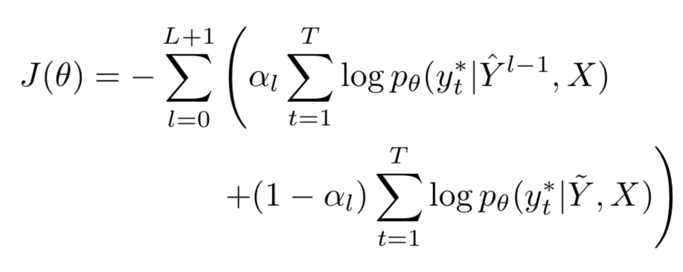
Non-autoregressive modeling by iterative refinement
Lower-bound maximization & Conditional Denoising
Mixed Training Objective
Consider L+1 iterations.
At each iteration, stochastically choose one of the two objectives.
Joint training from scratch
,

Slide 124
Experiments – Machine Translation
En↔Ro (WMT’16): low-resource machine translation
91.5% translation quality with up to 4x decoding speed-up (on GPU)
Non-Autoregressive? | Decoding | En→Ro (BLEU) | Ro→En (BLEU) | Speed (toks/sec)
 |  |  |  | CPU | GPU
No | Greedy | 31.93 | 31.55 | 15.7 | 55.6
 | Beam (4) | 32.40 | 32.06 | 7.3 | 43.3
Yes | Iter 1 | 24.45 | 25.73 | 98.6 | 694.2
 | Iter 2 | 27.10 | 28.15 | 62.8 | 332.7
 | Iter 5 | 28.86 | 29.72 | 29.0 | 194.4
 | Iter 10 | 29.32 | 30.19 | 14.8 | 93.1
 | adaptive | 29.66 | 30.30 | 16.5 | 118.3

Slide 125
Experiments – Machine Translation
En↔De (WMT’14): moderate-scale machine translation
80% translation quality with up to 2x decoding speed-up (on GPU)
Non-Autoregressive? | Decoding | En→De (BLEU) | De→En (BLEU) | Speed (toks/sec)
 |  |  |  | CPU | GPU
No | Greedy | 23.77 | 28.15 | 15.8 | 54.0
 | Beam (4) | 24.57 | 28.47 | 7.0 | 44.9
Yes | Iter 1 | 13.91 | 16.77 | 83.3 | 511.4
 | Iter 2 | 16.95 | 20.39 | 49.6 | 393.6
 | Iter 5 | 20.26 | 23.86 | 23.1 | 139.7
 | Iter 10 | 21.61 | 25.48 | 12.3 | 90.4
 | adaptive | 21.54 | 25.43 | 20.3 | 107.2

Slide 126
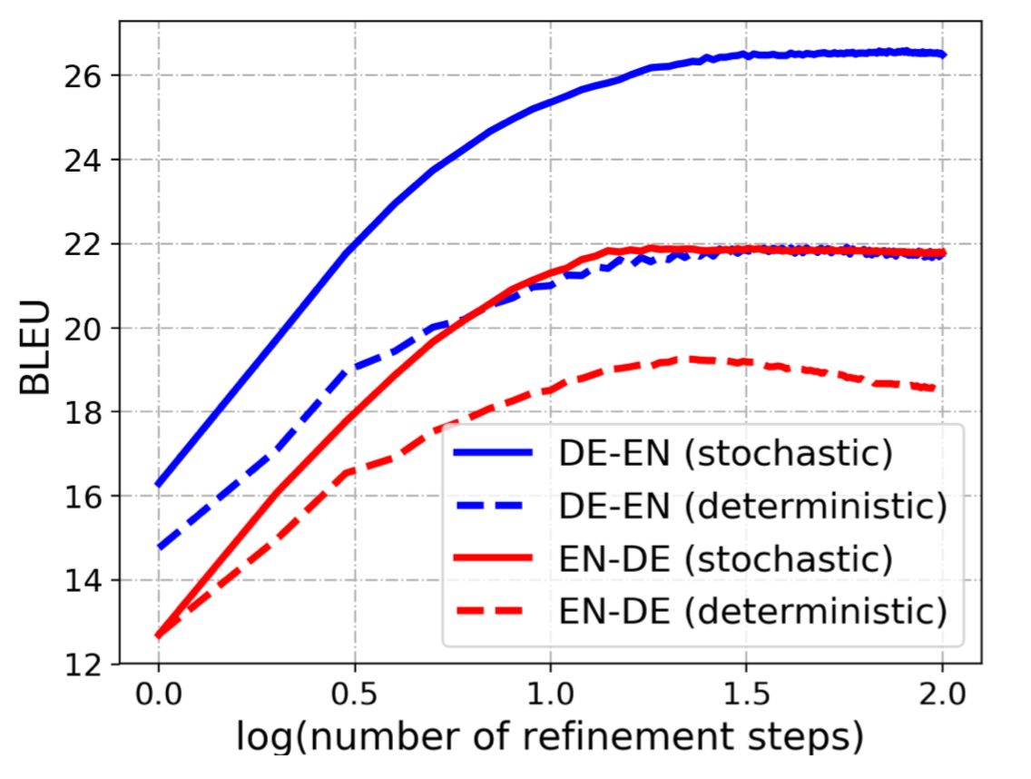
Experiments – Machine Translation
Iterative refinement improves translation quality (almost) monotonically
intermediate latent variables (translations) are successfully capturing dependencies.
Quality degradation with large data
Significant speed-up in decoding on GPU
Perhaps more suitable for brains? ☺

Slide 127
Experiments – Machine Translation
Src: seitdem habe ich sieben Ha ̈user in der Nachbarschaft mit den Lichtern versorgt und sie funktionierenen wirklich gut .
Iter 1: and I ’ve been seven homes since in neighborhood with the lights and they ’re really functional .
Iter 4: and I ’ve been seven homes in neighborhood with the lights , and they ’re a really functional .
Iter 8: and I ’ve been providing seven homes in the neighborhood with the lights and they ’re a really functional .
Ref: since now , I ’ve set up seven homes around my community , and they ’re really working .
Src: er sah sehr glu ̈cklich aus , was damals ziemlich ungewo ̈hnlich war , da ihn die Nachrichten meistens deprimierten .
Iter 1: he looked very happy , which was pretty unusual the , because the news was were usually depressing .
Iter 4: he looked very happy , which was pretty unusual at the , because news was mostly depressing .
Iter 8: he looked very happy , which was pretty unusual at the time because the news was mostly depressing .
Ref: there was a big smile on his face which was unusual then , because the news mostly depressed him .

Slide 128
Experiments – Image Caption Generation
MS COCO: image caption generation
85% caption quality with up to 5x decoding speed-up (on GPU)
Non-Autoregressive? | Decoding | BLEU | Speed (toks/sec)
 |  |  | CPU | GPU
No | Greedy | 23.47 | 4.3 | 2.1
 | Beam (4) | 24.78 | 3.6 | 1.0
Yes | Iter 1 | 20.12 | 17.1 | 8.9
 | Iter 2 | 20.88 | 12.0 | 5.7
 | Iter 5 | 21.12 | 6.2 | 2.8
 | Iter 10 | 21.24 | 2.0 | 1.2
 | adaptive | 21.12 | 10.8 | 4.8

Slide 129
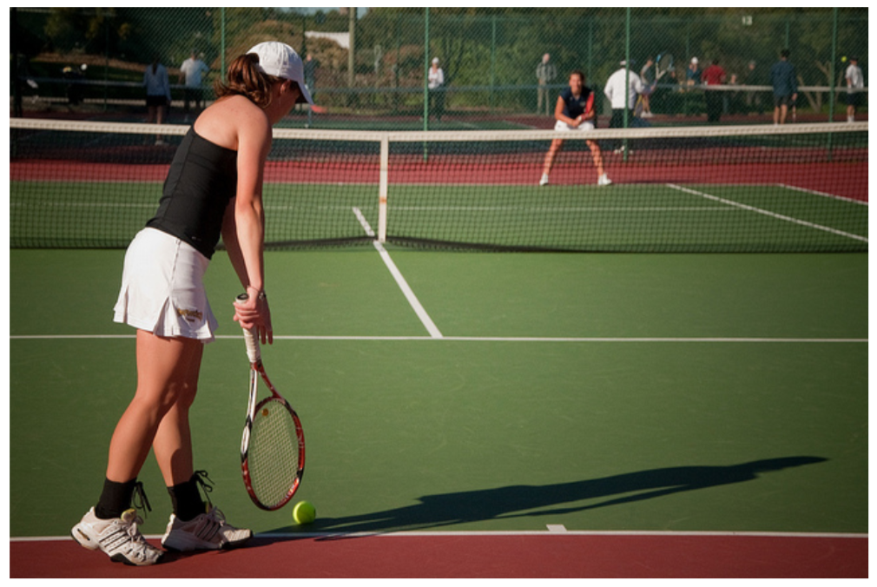
Non-autoregressive modeling by iterative refinement
a woman standing on playing tennis on a tennis racquet .
a woman standing on a tennis court a tennis racquet .
a woman standing on a tennis court a a racquet .
a woman standing on a tennis court holding a racquet .
Input

Slide 130
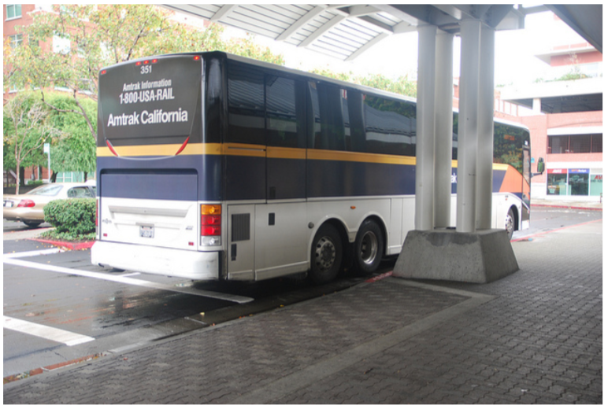
Non-autoregressive modeling by iterative refinement
a yellow bus parked on parked in of parking road .
a yellow and black on parked in a parking lot .
a yellow and black bus parked in a parking lot .
a yellow and black bus parked in a parking lot.
Input

